Slide 1
Special Input Output (IOT)
Online variable veranderen met Arduino’s met wifi en ajax
COLOR MATCHING MINI-GAME
Mike Raadsheer
2556 - GD2B

Slide 2
Wat we gaan bespeken
Hardware
Software
Design
Tests

Slide 3
Hardware
Input – Arduino (Node MCU) / online forms
Output – Web page

Slide 4
Software
Node MCU
HTML, JS, AJAX, PHP, CSS

Slide 5
Design
Product
Reason
Doelgroep

Slide 6
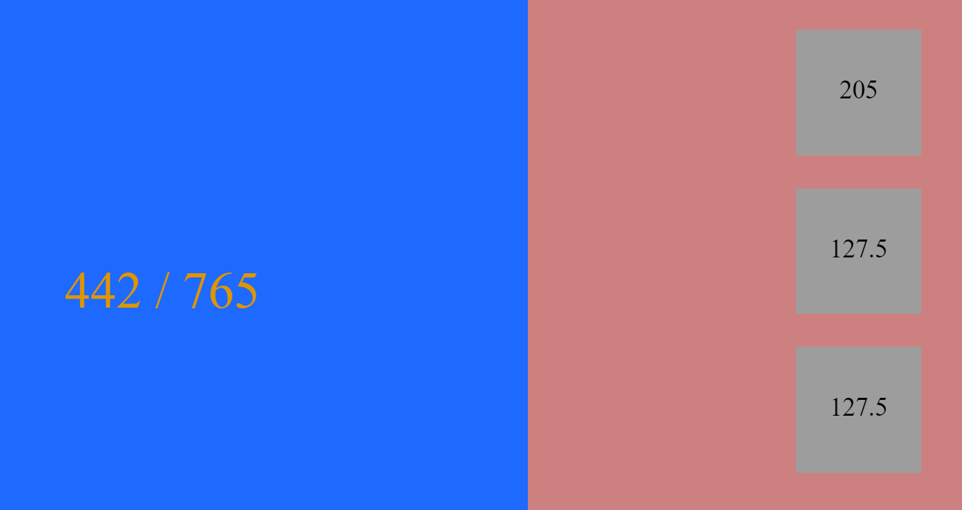
Tests
Server side requests (ajax)
Arduino converting a voltage to a float
Node MCU

Slide 7
Vragen?

